Slide 1
Scaling up open-source batteries: what's worth pursuing?
Kirk Smith Ph.D., Daniel Fernandez Ph.D.

Slide 2
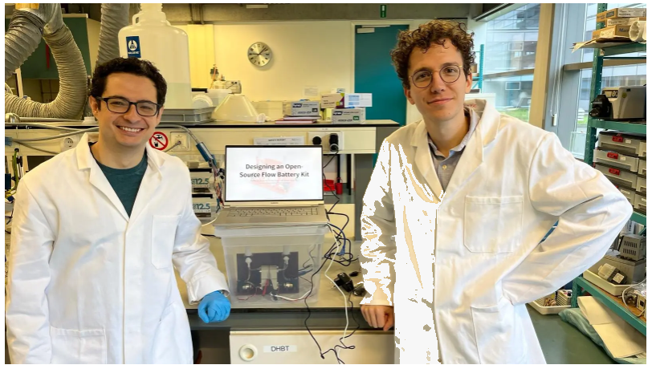

fbrc.dev

Slide 3
Why open source energy storage?
No open source energy storage solution exists.
The task is not trivial.
Currently no clear path to create rechargeable energy storage with reproducible characteristics from raw materials.
An open source alternative will improve energy independence and enhance industrial development.
An open source alternative should improve energy storage access in developing countries.

Slide 4
Goals
Open source licensing.
Medium and large scale storage.
Low material costs.
High reliability.
High material availability.
Openly available characterization.
Open source characterization hardware and software.

Slide 5
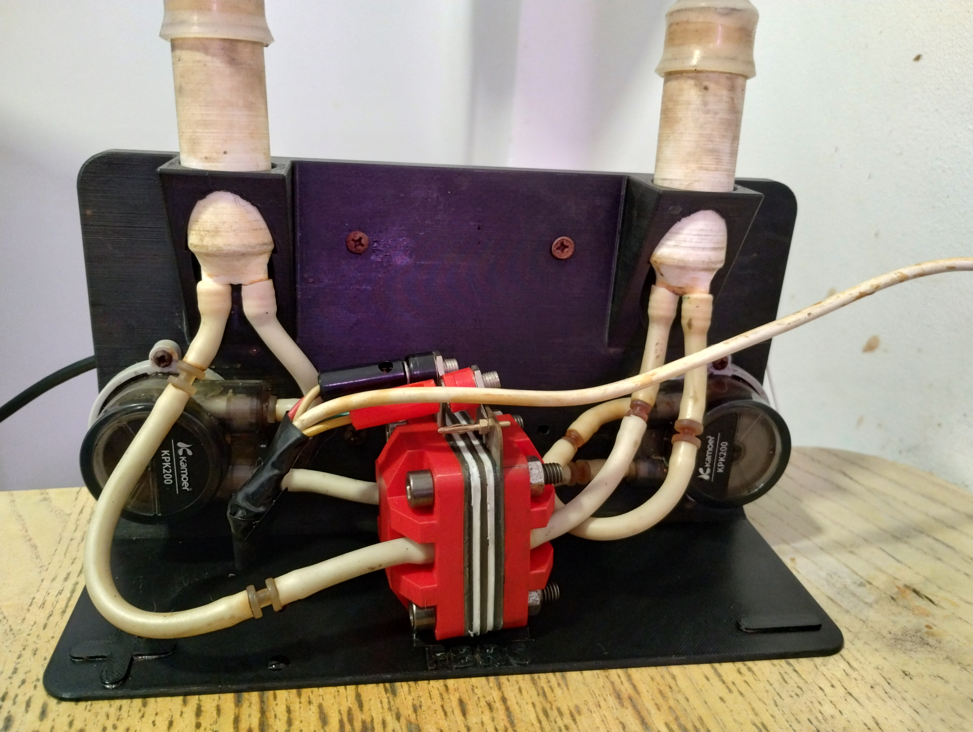

Slide 6
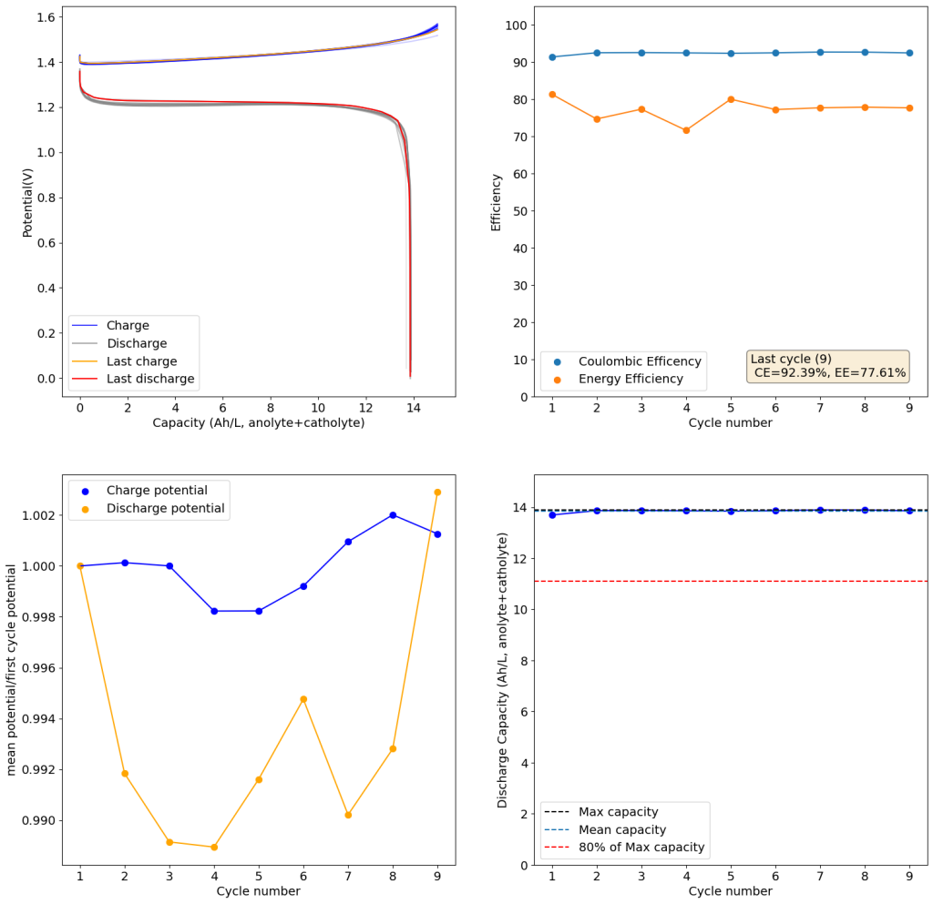
Kit tested with
Zinc-Iodine chemistry
Achieved hundreds of hours of stable cycling. Zn-I battery chemical costs ~80 USD/kWh

Slide 7
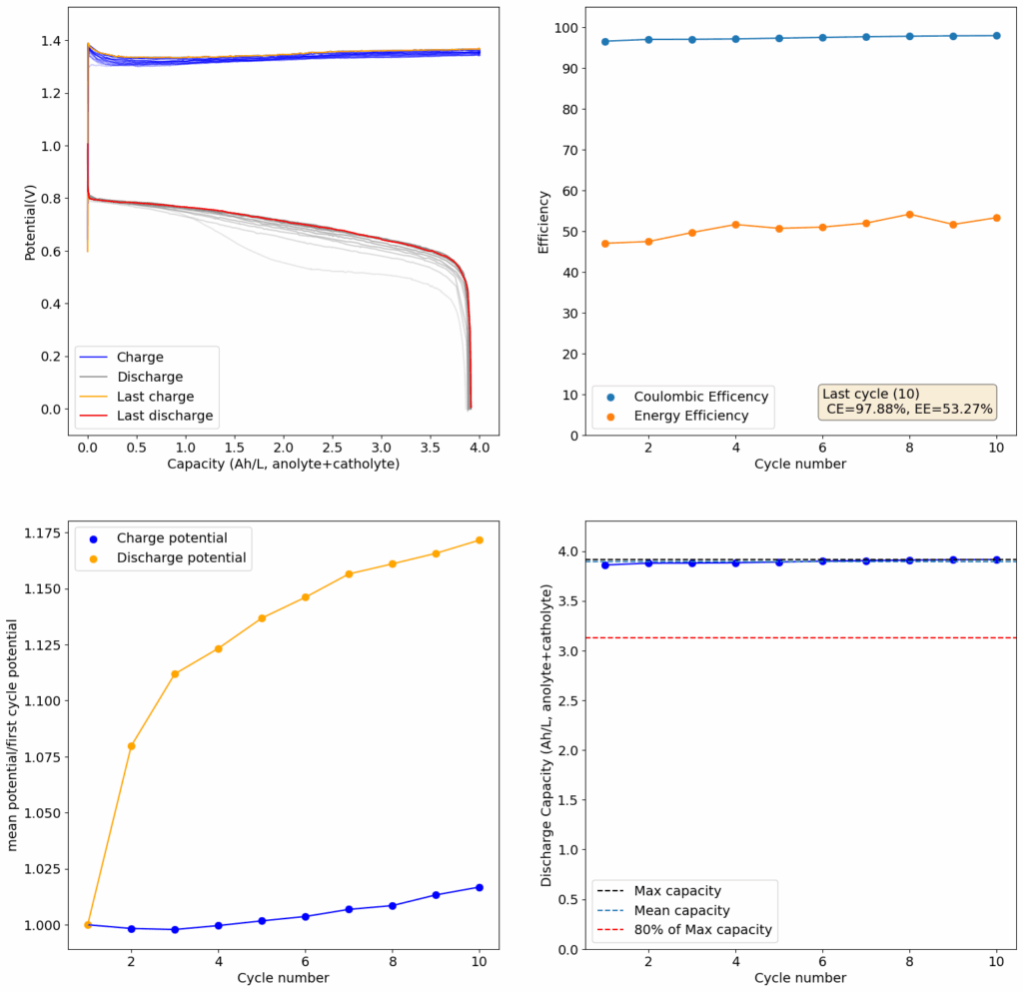
Currently testing lower cost All-Fe chemistries using innovative MgCl₂ and CaCl₂ electrolytes. Fe- CaCl₂ battery chemical costs ~30 USD/kWh

Slide 8
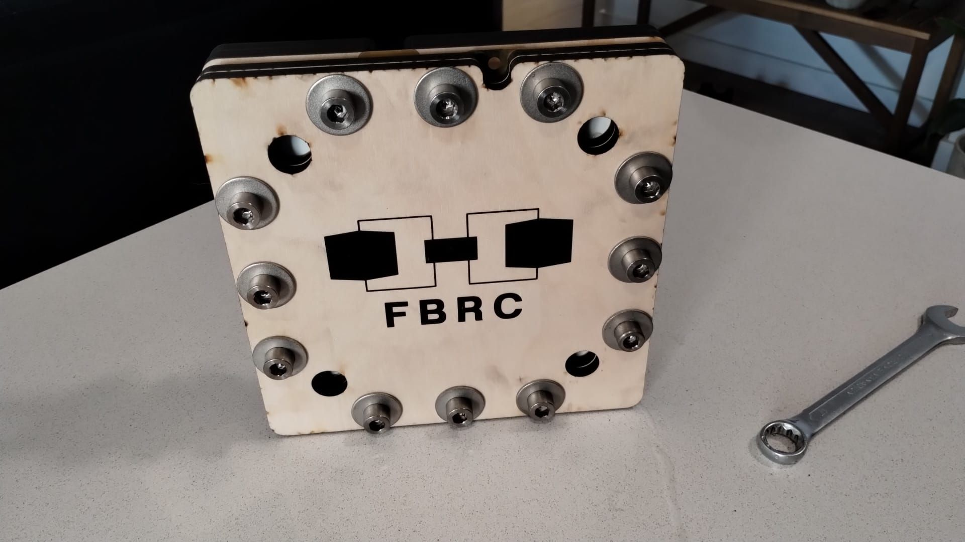

Slide 9
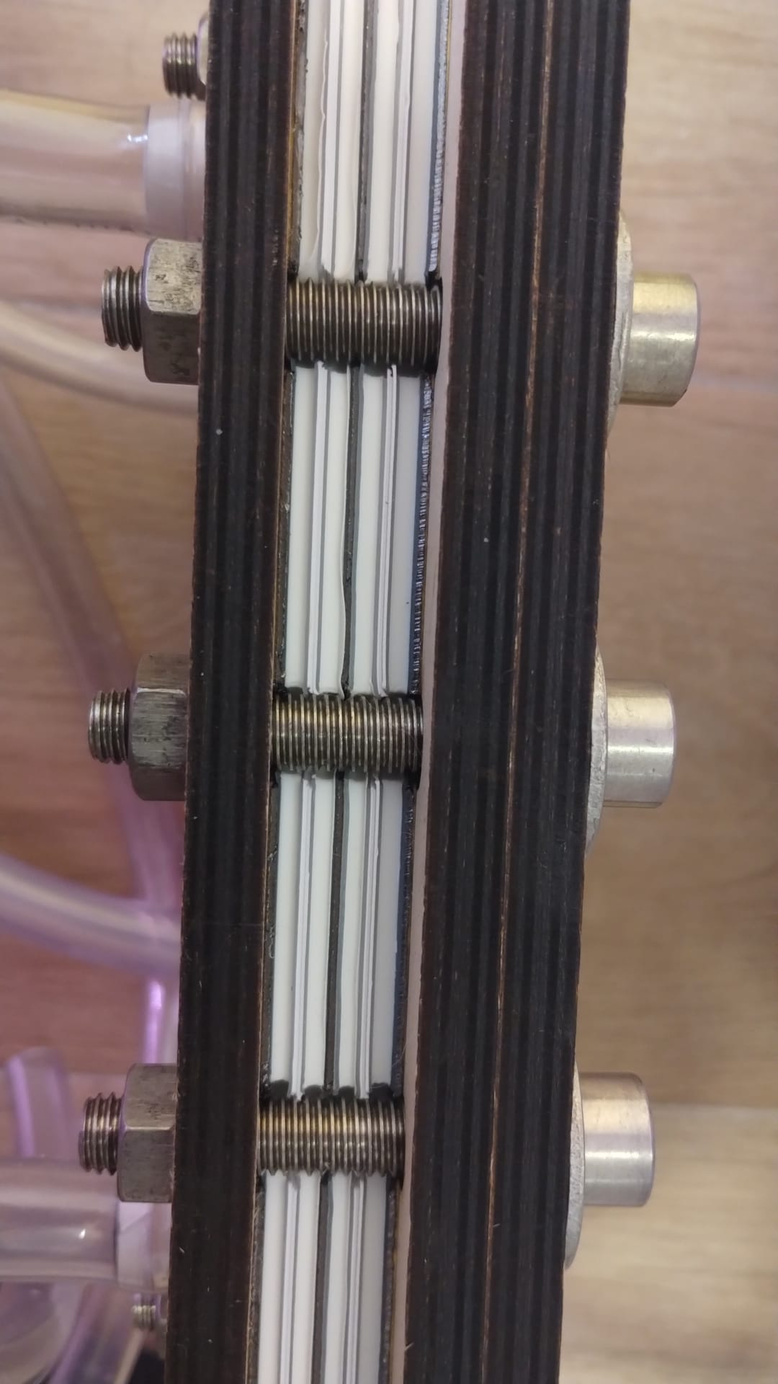

Slide 10
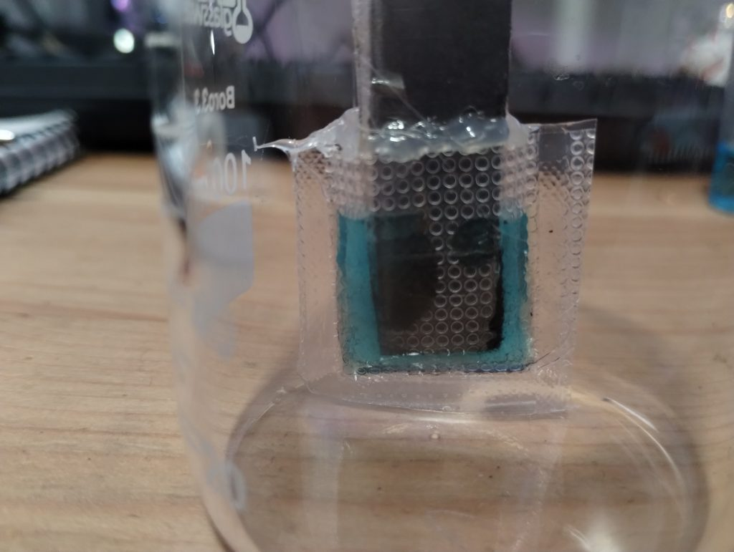
Static battery using Cu/Mn chemistry in methanesulfonic acid (MES)
Tested with carbon felt and grafoil electrodes

Slide 11
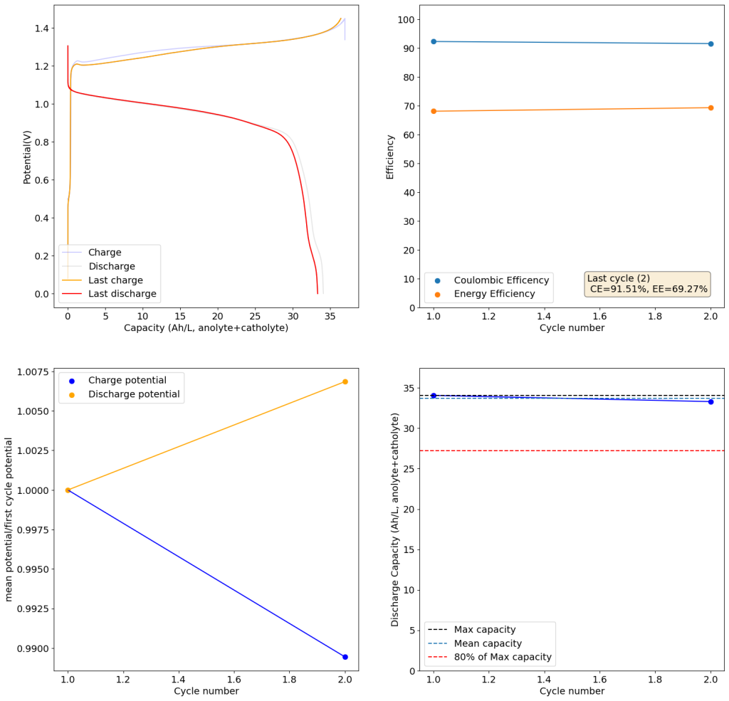
Achieved good stability and high energy density
30-35Wh/L, comparable to lead batteries
Cost is 8-16 USD/kWh

Slide 12
Material | Qty for 1 kWh | Unit price | Cost
CuSO₄·5H₂O (copper sulfate) | 5.71 kg | $1.40/kg | $8.00
MnSO₄·H₂O (manganese sulfate) | 3.86 kg | $0.45/kg | $1.74
Methanesulfonic acid (70%) | 7.85 kg | $1.55/kg | $12.17
Conductive carbon felt (battery grade) | 5.714 m² | $25/m² | $142.85
Graphite current collectors (cathodes), 2 mm assumed | 2.857 m² → ~10.29 kg | $6/kg | $61.71
Copper current collectors (anodes), 0.5 mm assumed | 2.857 m² → ~12.80 kg | $5.90/kg | $75.52
Celgard separator | 2.857 m² | $2.20/m² | $6.29
Full 1kWh battery estimated material cost: ~310 USD
For comparison FeLiPo cost/kWh is currently 60-80 USD

Slide 13
Material | Quantity | Unit price used (bulk) | Cost
CuSO₄·5H₂O | 5.71 kg | $1.40/kg | $8.00
MnSO₄·H₂O | 3.86 kg | $0.40/kg | $1.54
Methanesulfonic acid (MSA) 70% | 7.85 kg | $1.55/kg | $12.17
Calcined petroleum coke (CPC) | 22.6 kg | $0.60/kg | $13.56
Activated carbon (10 wt%) | 2.66 kg | $2.37/kg | $6.30
Conductive carbon black (3 wt%) | 0.80 kg | $1.20/kg | $0.96
PTFE binder (2 wt%) | 0.53 kg | $10/kg | $5.30
Separator (microporous PP film “Celgard-type”) | 2.857 m² | $1.70/m² | $4.86
Titanium tabs (only) | small | commodity Ti; negligible at this scale | ~$0–$2
Full 1kWh battery estimated material cost: ~55 USD

Slide 14
Our plan
Continue to test and validate our large scale flow battery cell.
Produce stable charge/discharge curves with the large flow cell.
Implement a 1kWh stacked flow battery using Zn-I at 12V.
Validate the Fe chemistry at a small scale so that we can pursue a large scale implementation.
Test a small scale pretroleum coke Cu-Mn battery.
Test a medium scale design for a Cu-Mn battery (35-100Wh).
Continue to explore interesting chemistries at a small scale.

Slide 15

Thank you!

